Slide 1
Manufacture Management System
Software Engineering Laboratory

Slide 2
Problem Statement:
The process of Manufacture Management System is very difficult to do traditionally. Every large manufacture company has multiple management levels and each management levels have their different parts.
Manufacture Management System Software plays an important role in handling this complex process of a manufacture company.

Slide 3
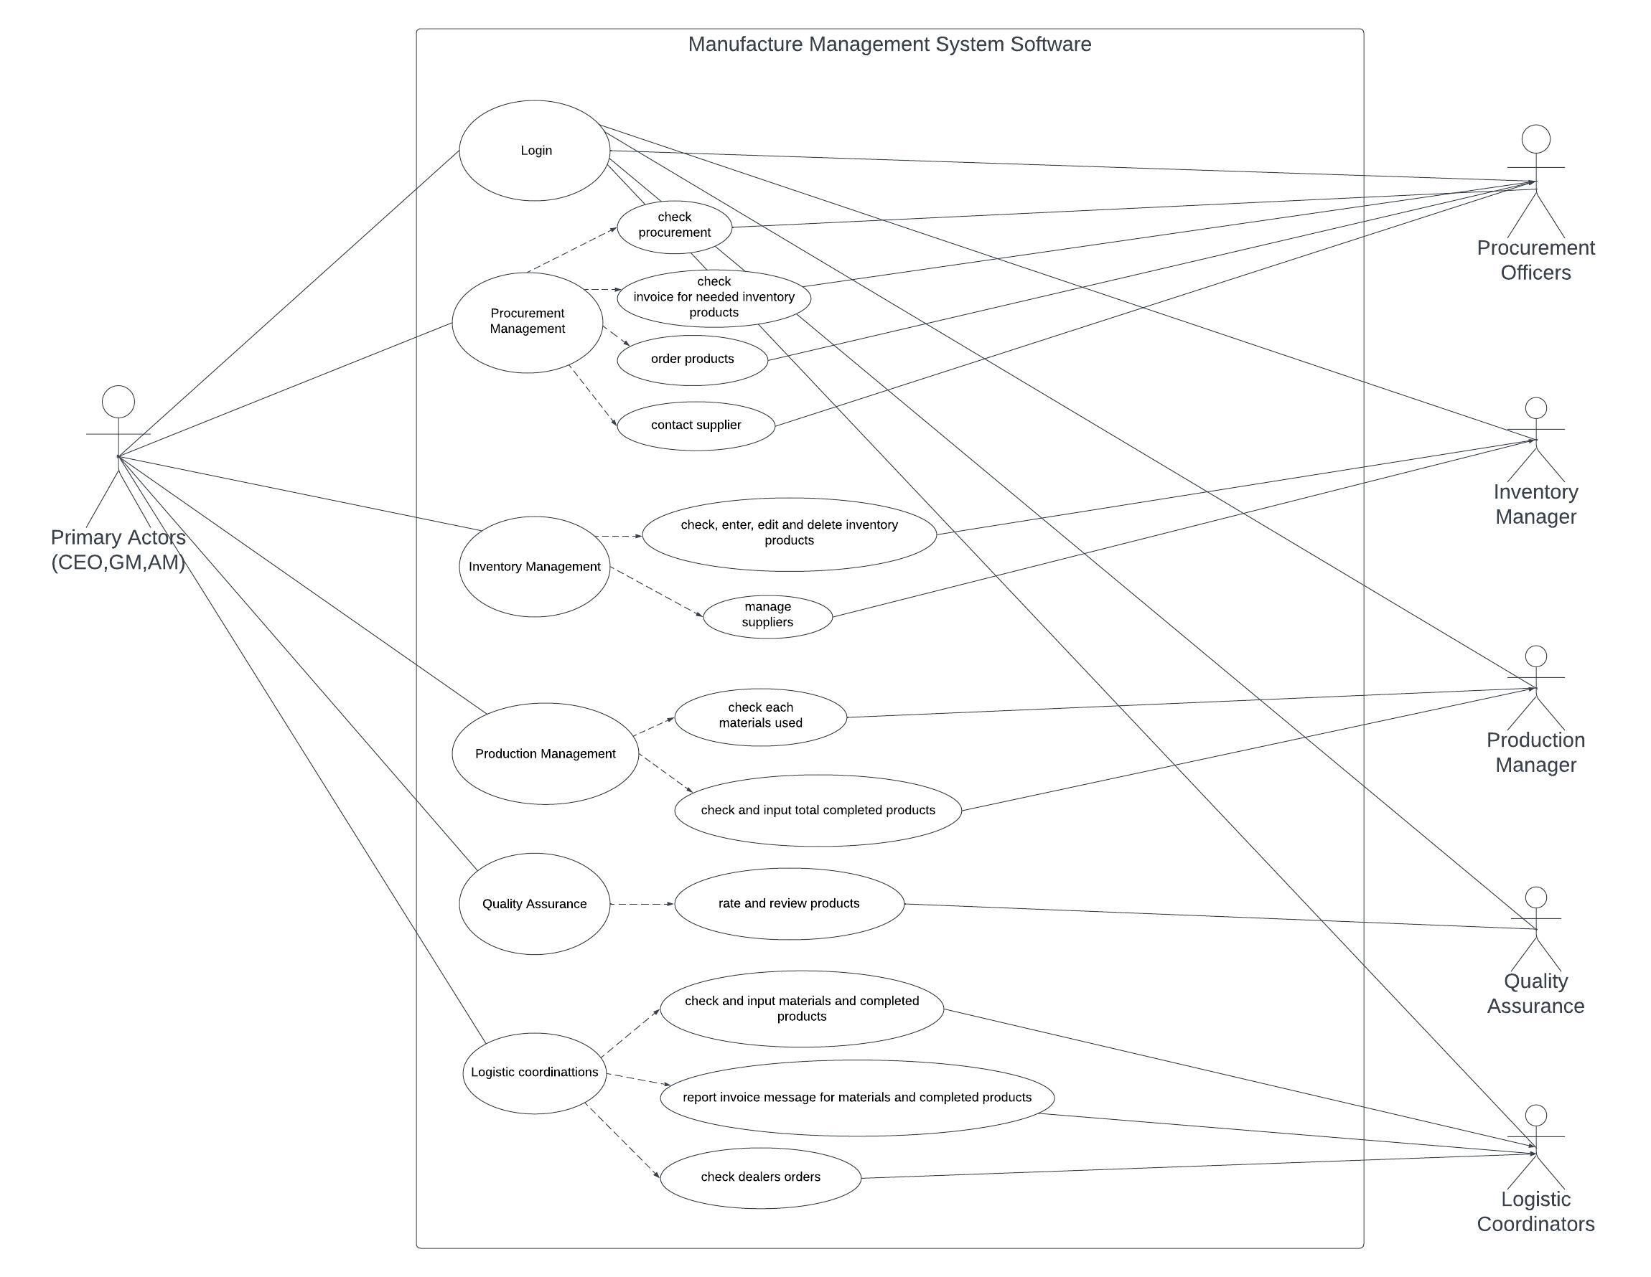
Use-Case Diagram:

Slide 4
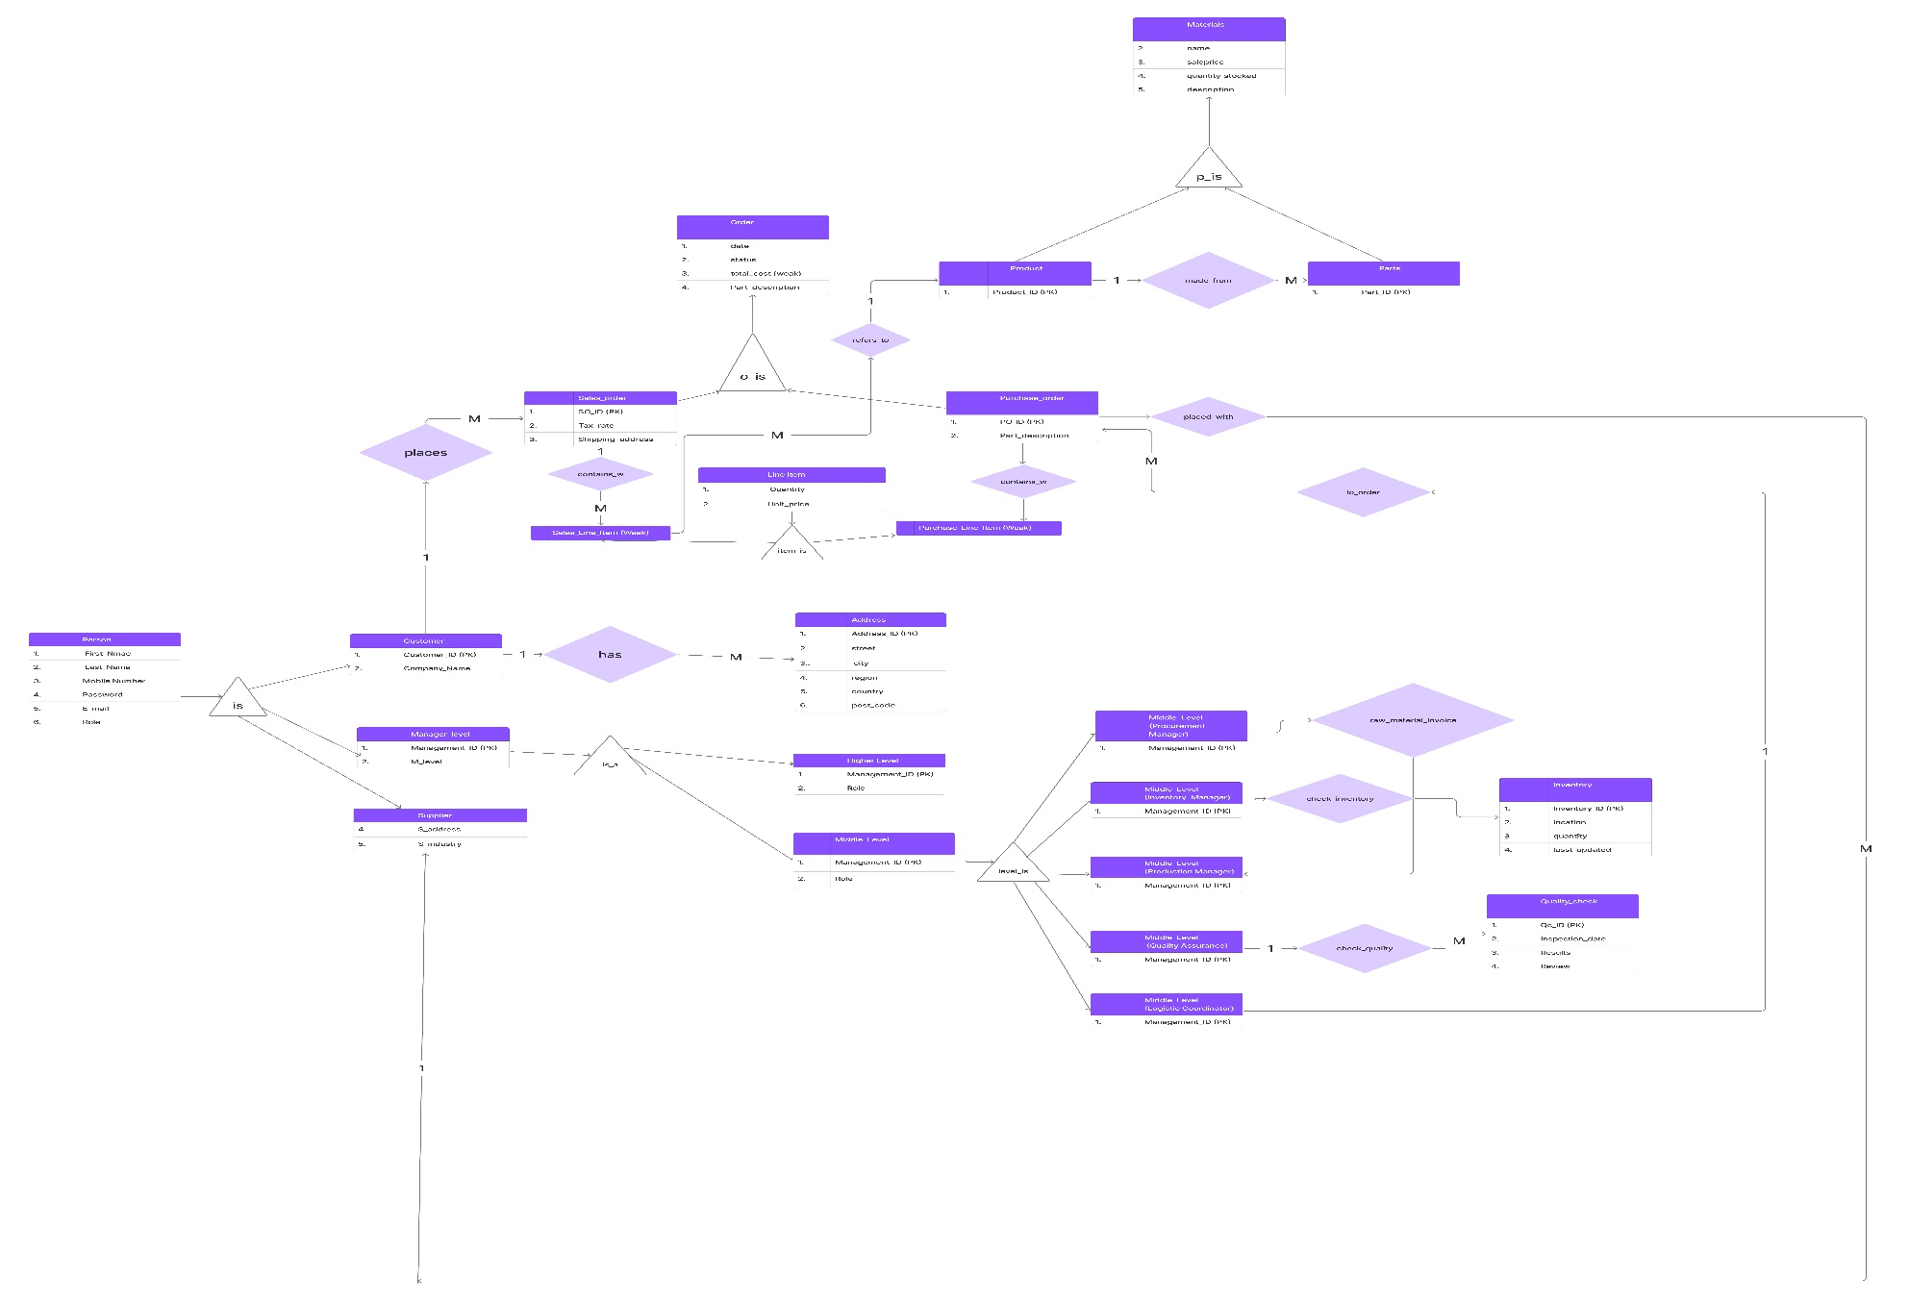
ERD Diagram:

Slide 5
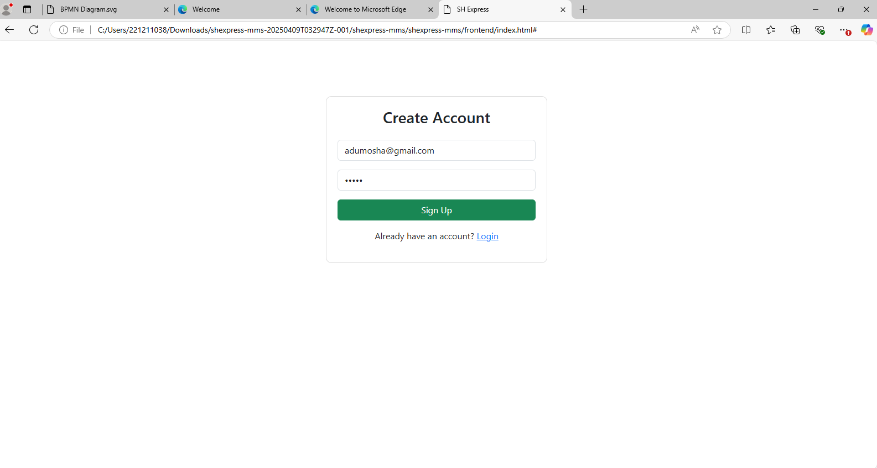
Sign Up:

Slide 6
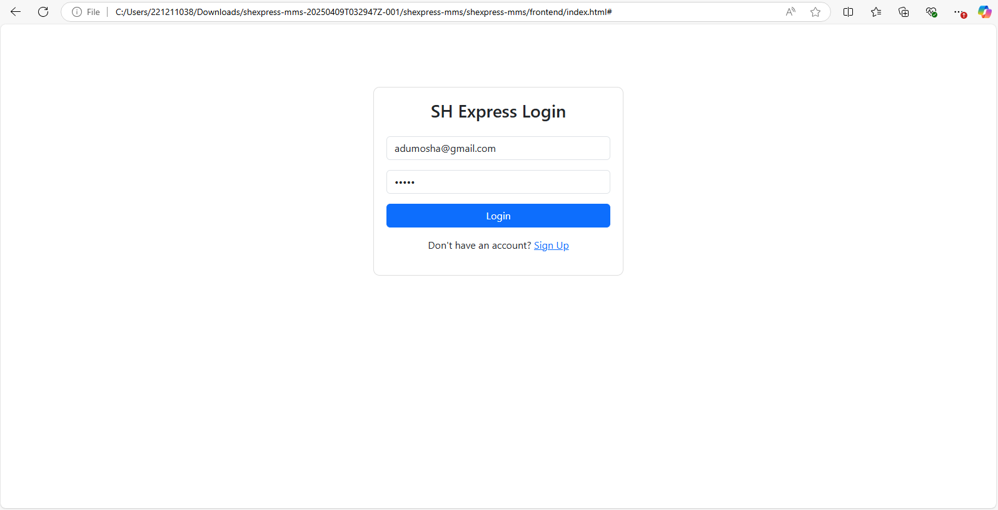
Login:

Slide 7
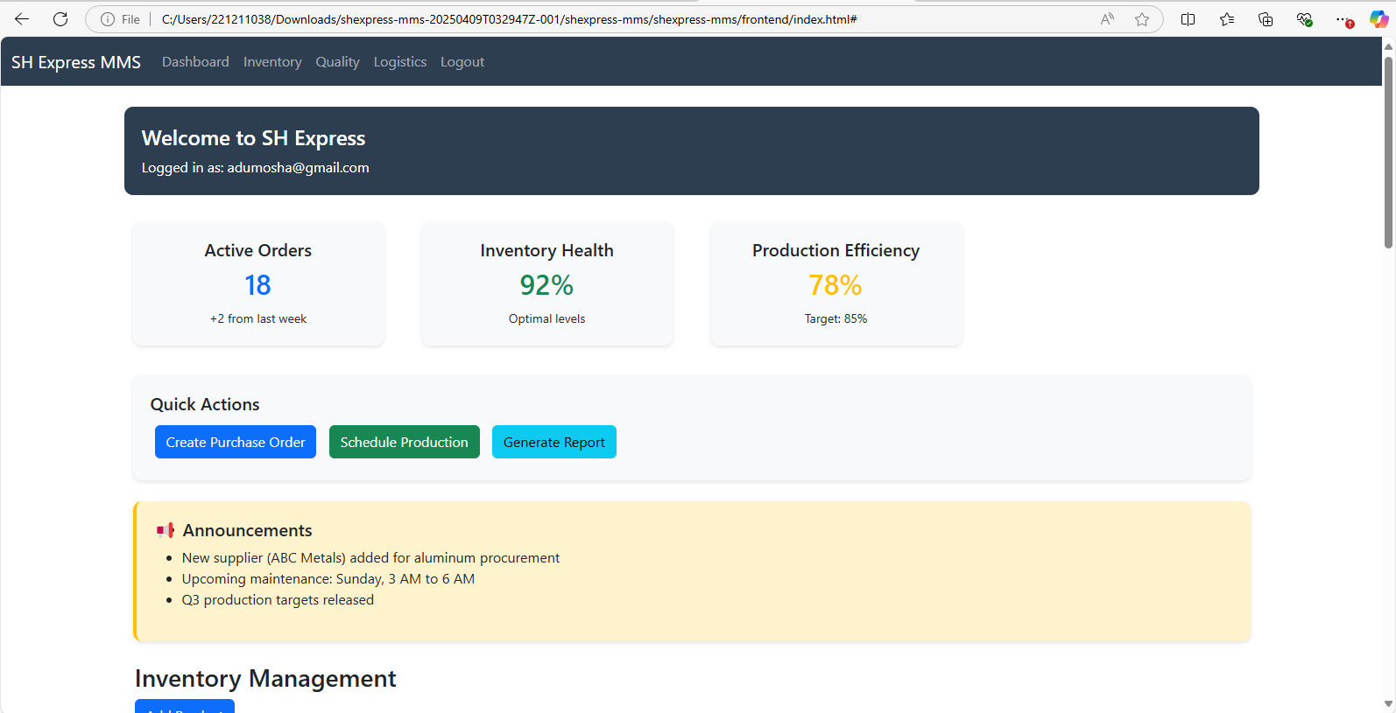
Dashboard Section:

Slide 8
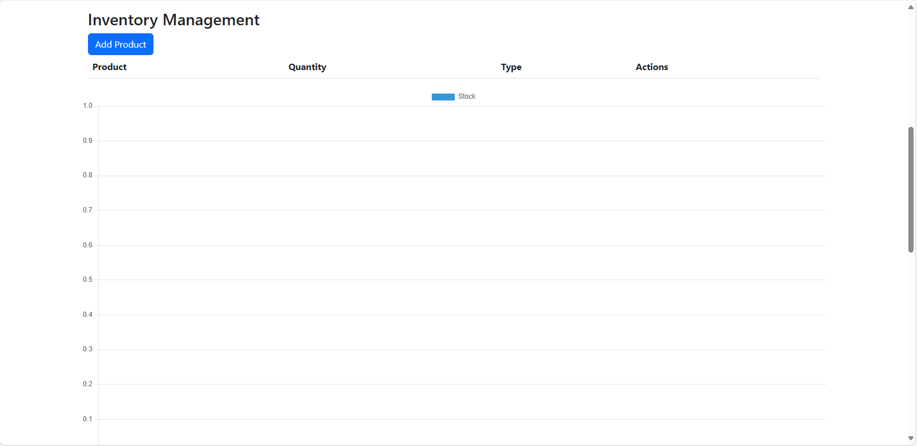
Inventory Management:

Slide 9
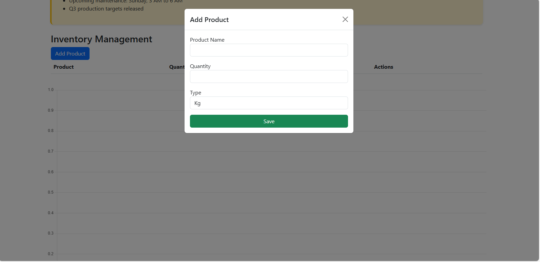
Inventory Management:

Slide 10
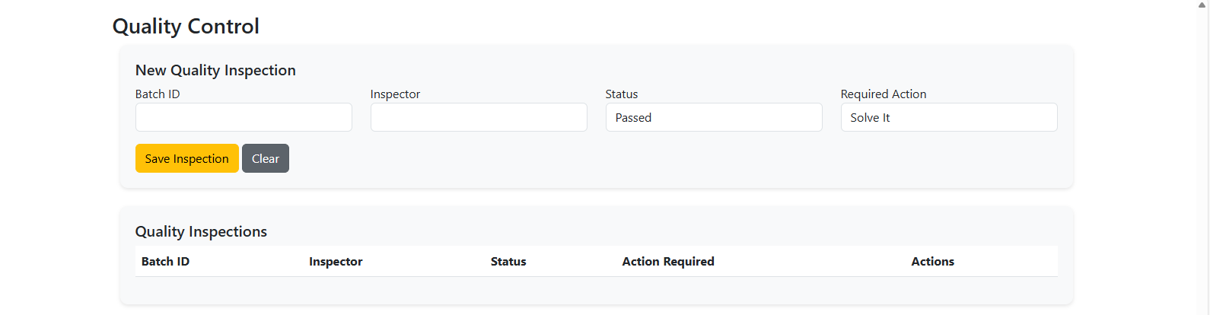
Quality Control:

Slide 11
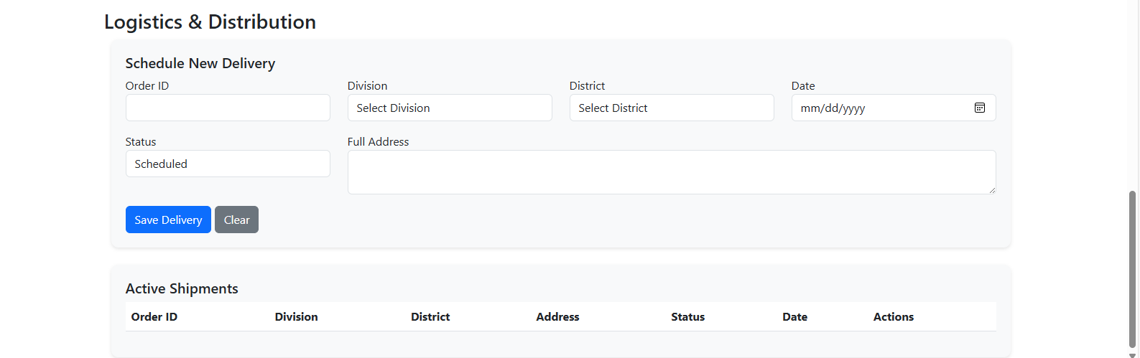
Logistics and Distribution:

Slide 12
Future Works:
1. Backend code is prepared but connection between them will be applied.
2. Each features will be worked on so that it would show separately.

